Slide 1


Quantum Random Number Generation
Quantum Computing
2023
</
/>
} /> [
Mikhail Varghese, Christophe Moll, and Samantha Moll

Slide 2
</ Table of contents
{01}
{04}
Classical Randomness
Applications of Quantum Random Number Generators
{02}
Quantum Randomness
{05}
{03}
Conclusion
Implementation of QRNG

Slide 3
01
Classical
Randomness
Quantum Computing
2023
</>
} /> [

Slide 4

</ What is Classical Randomness?
Randomness: the quality or state of lacking a pattern or principle of organization; unpredictability
Random Process → one in which each event or outcome is independent of the previous ones and cannot be reliably predicted

Slide 5
</ True vs. Pseudo Randomness
Pseudo-Randomness
Generates numbers using efficient, periodic, deterministic algorithms
Starts with a seed value
Uses mathematical formulas to produce a sequence of numbers that appears to be random
→ Sequence will repeat after a certain period, making it predictable if the initial seed is known
True Randomness
Generates numbers using genuinely unpredictable sources, often from physical processes
E.g. atmospheric noise, radioactive decay, electronic noise
Non-deterministic → No algorithm or formula to predict values
Lower efficiency
Notes:
deterministic : a given sequence of numbers can be reproduced at a later date if the starting point in the sequence is known
Periodic : the sequence will eventually repeat itself

Slide 6

</ Applications of Randomness
Pseudo-Randomness
Used in computer simulations, procedural generation, randomized algorithms, etc…
Not suitable for applications where it is important that the numbers are really unpredictable
E.g. data encryption and gambling
True Randomness
Used in lotteries, gambling, simulation and modelling certain mathematical scenarios, security (e.g. generation of data encryption keys)
Used where unpredictability and fairness are crucial

Slide 7

</ Importance of True Randomness
Rise of quantum computers → Potential to break traditional cryptographic systems that rely on pseudo-randomness
Can solve mathematical problems currently computationally impossible for classical computers
E.g. Shor's algorithm (factor large numbers quickly), threatening the security of encryption methods like RSA
True randomness → Essential for generating encryption keys that cannot be predicted or reversed
Ensures data security and confidentiality

Slide 8
02
Quantum
Randomness
Quantum Computing
2023
</>
} /> [

Slide 9
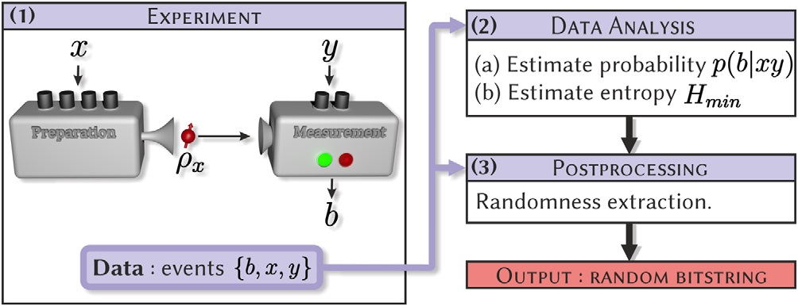
</ Introduction to Quantum Randomness
Quantum Randomness
Subset of true randomness
Inherent unpredictability that arises in quantum systems
Quantum Random Number Generators (QRNGs)
Devices that utilize principles of quantum mechanics (quantum randomness) to produce true random numbers

Slide 10
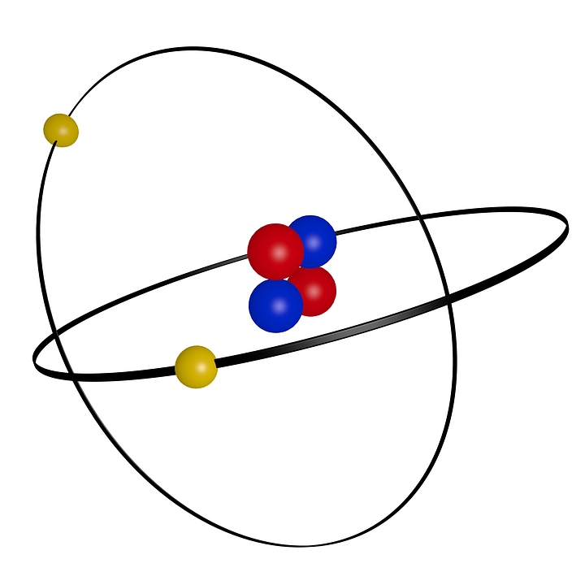
</ Quantum Properties
Fundamental properties that lead to true randomness in quantum systems:
Superposition: Ability of a quantum system to be in multiple states simultaneously, until it is measured
Entanglement: Exchange of quantum information between two particles at a given distance → measuring one entangled particle affects the other instantaneously. For example, if one electron is in the state of spin up, then the other will be in the state of spin down, regardless of the distance between the two

Slide 11
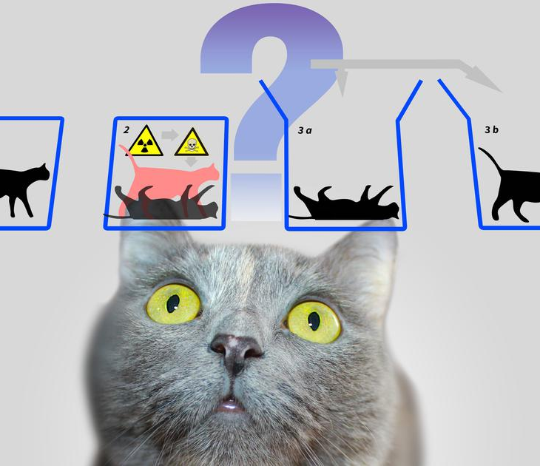
</ Quantum Properties
Fundamental properties that lead to true randomness in quantum systems:
Measurement Uncertainty: Measuring the state of a quantum system is probabilistic, as its outcomes are unpredictable
Bell’s Theorem: No hidden variables → Quantum randomness is not controlled by any deterministic values

Slide 12
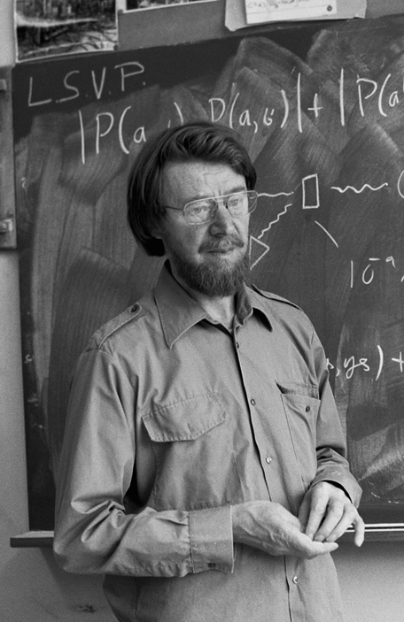
</ Superdeterminism and Bell’s Theory
Superdeterminism (Hidden Variables)
Controversial interpretation of quantum mechanics
Suggests universe is entirely deterministic → all events predetermined and lack true randomness
Proposes that hidden variables control behavior of particles → no true quantum randomness
Bell's Theory
Bell inequalities → tested validity of superdeterminism
Showed that quantum systems violate these inequalities
Cannot be explained by any local hidden variables or classical deterministic explanations
Reaffirmed presence of true quantum randomness in nature
Notes:
(SM)
1960s, physicist John Bell formulated a series of groundbreaking theorems (Bell's inequalities)

Slide 13
03
Implementation
Of QRNG
Quantum Computing
2023
</>
} /> [

Slide 14
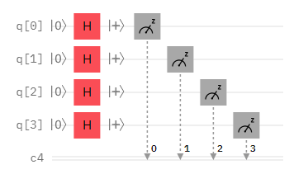
</ Quantum Random Number Generator
Implementation using Qiskit
4-qbit random number generator
Outputs 0-15 in binary
Uses the property of 50/50 superposition for RNG
Quantum algorithm
Uses a Hadamard gate on each bit and then collapses everything to generate the number
Notes:
The H gate puts all the qubits in a ket + state which is then collapsed by measuring the z axis.

Slide 15
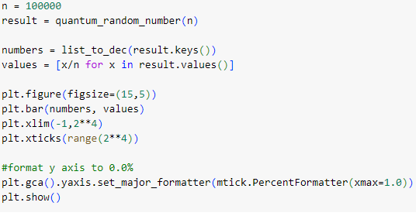
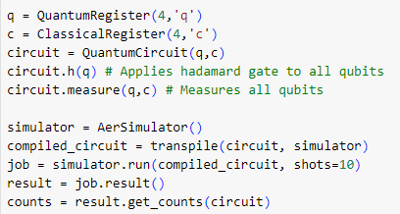
</ Python Code
Histograms
Qiskit

Slide 16
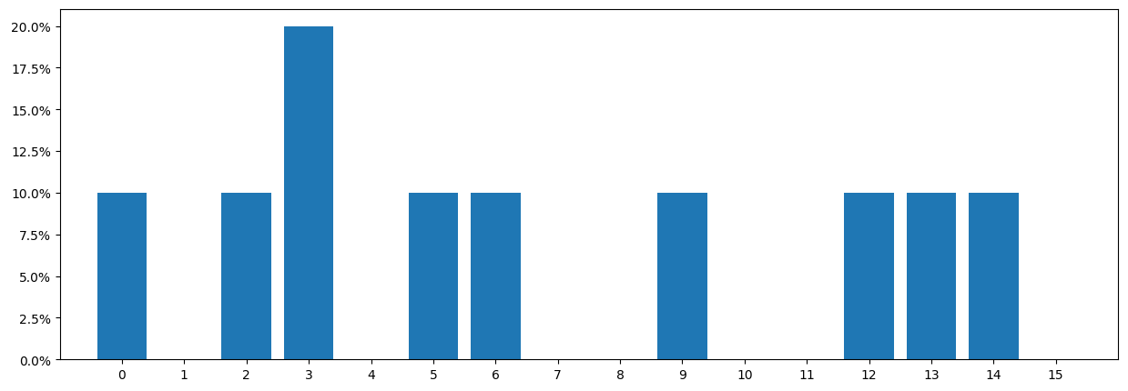
</ Simulation Results
Ran using Qiskit’s AerSimulator
10 simulations

Slide 17
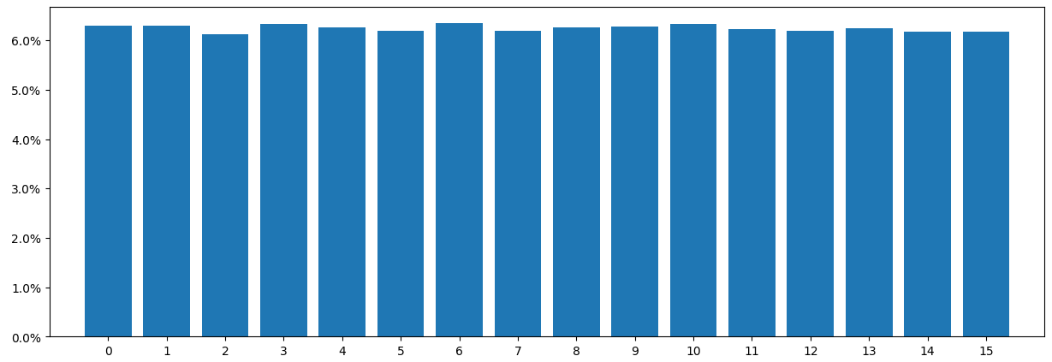
</ Simulation Results
Ran using Qiskit’s AerSimulator
100,000 simulations

Slide 18
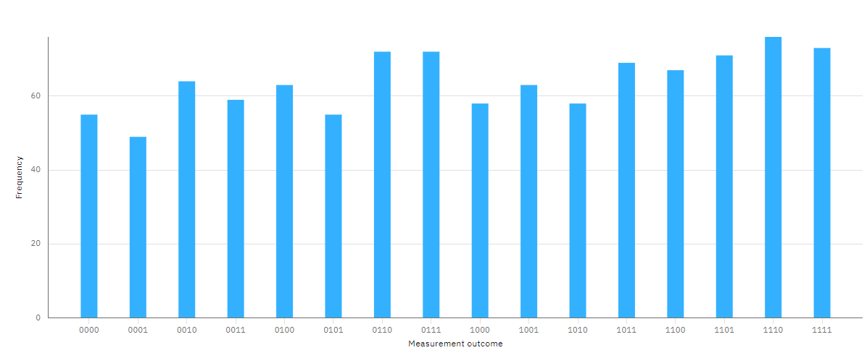
Job run on ibm_perth | # of shots : 1024 Usage of 4s | Running: Jul 24, 2023 4:11 PM

Slide 19
04
Applications of
QRNGs
Quantum Computing
2023
</>
} /> [

Slide 20
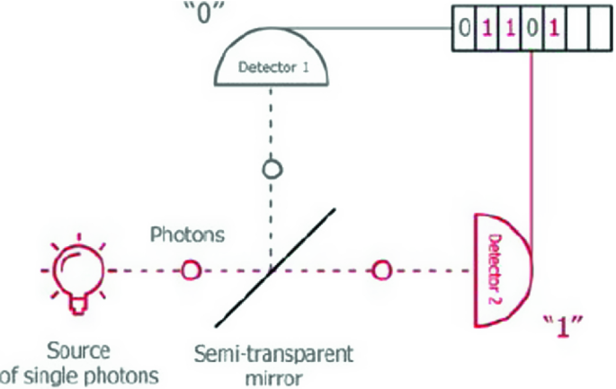
</ Types of QRNGs
Photon-Based
Atomic-Based
Two main categories of Quantum Random Number Generators:
Use unpredictable behavior of photons to generate random numbers
E.g. polarization or arrival times
Uses quantum properties of atoms to generate random numbers
E.g. decay of radioactive isotopes or quantum spin states

Slide 21
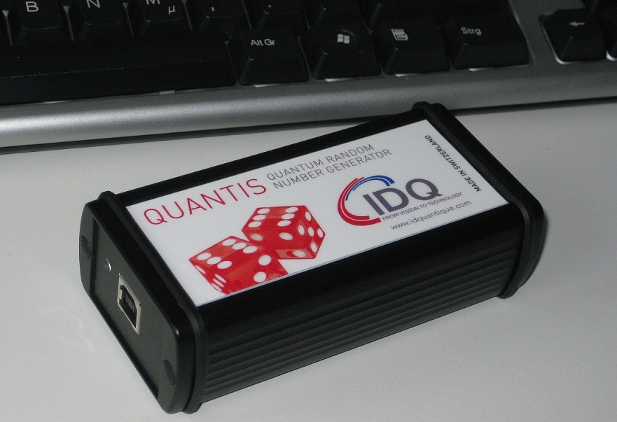
</ Example: Photon-Based
ID Quantique’s Quantis QRNG chip
ID Quantique
Developed world’s smallest QRNG chip → Quantis chip
Utilizes photon-based quantum processes (beam splitter) to generate true randomness
Can be embedded into any IoT or mobile device
Making quantum-enhanced security available to everyone

Slide 22
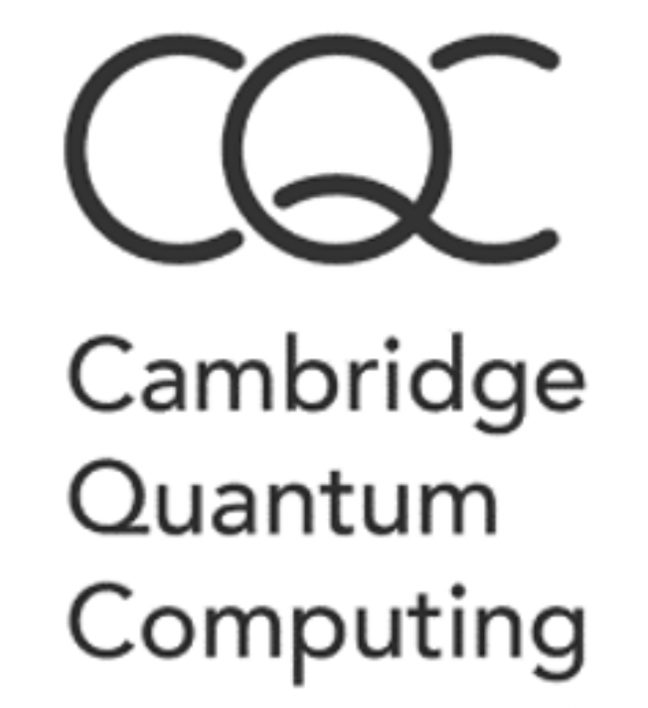
</ Example: Atomic-Based
Cambridge Quantum Computing’s IronBridge
Cambridge Quantum Computing
Developed the first provable QRNG → Ironbridge
Uses atomic-based (nuclear spin) quantum computers to generate unbiased randomness
Generates cryptographic keys using quantum randomness
Results in Quantum-proof keys
Safe from classical and quantum algorithms

Slide 23
</ Applications
Cryptography
Also used for:
Scientific simulations
Quantum simulations
Introduce random noise → more accurate and closer to real-world scenarios
Crucial simulations for understanding quantum systems and solving quantum problems
Certain Randomized algorithms
Gaming and gambling
Ensure fairness in online gambling platforms, lotteries, and casino games
Main application:
Vital role in enhancing security of cryptographic systems
Provide source of unpredictable randomness
Essential for generating encryption keys
Ensure secure communications and protect sensitive data

Slide 24
05
Conclusion
Quantum Computing
2023
</>
} /> [

Slide 25
</ Advantages
Protection against attacks
Resistant to algorithmic attacks that can compromise traditional PRNGs
Reliable entropy source
QRNGs are valuable for applications requiring high-quality random numbers
E.g. simulations and scientific research
True randomness
Generate genuinely random numbers based on quantum phenomena → unpredictable
Enhanced security
Provide stronger cryptographic keys → reduces risk of data breaches

Slide 26
</ Disadvantages and Limitations
Hardware complexity
Implementation requires specialized quantum technologies
More complex and expensive than conventional PRNGs
Limited scalability
Difficult to scale up for mass production
Environmental sensitivity
Sensitive to environmental factors
E.g. temperature and electromagnetic interference
Quantum noise
Can be influenced by surrounding noise → leading to potential inaccuracies

Slide 27
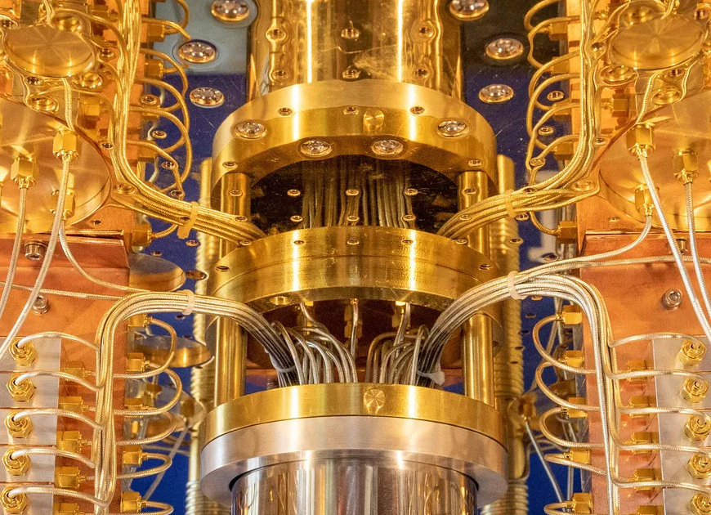

Thanks for listening!
Quantum Computing
2023
</
} /> [
/>

Slide 28
</ Bibliography
} /> [
Quantum random number generation
A Comprehensive Review of QRNGs
Quantum-Proof Cryptography with IronBridge, TKET and Amazon Braket
Quantum Random Number Generators
Practical Considerations and Use Cases for QRNGs
Quantum Random Number Generation Applications - ID Quantique
Quantum Random Number Generation (QRNG) - ID Quantique
Quantum Advantage Now: Generation of True Random Numbers | by Jack Krupansky
Everything You Wanted to Know About Quantum Random Number Generators
Introduction to Randomness and Random Numbers
Bell's theorem - Wikipedia
/>

